Slide 1


Todd Kurtz
July 2, 2023

Slide 2

Outline
Executive Summary
Introduction
Methodology
Results
Conclusion
Appendix

Slide 3
Executive Summary
This capstone will try to predict if Space X Falcon 9 first stage will land successfully using machine learning and Data Collection, Data Wrangling and Formatting
The process for the project used the following steps:
Data Collection
Exploratory data analysis
Visualization
Machine Learning Prediction
Based on different aspects of the rocket launch, we will try and determine whether the outcome will be a success or failure

Slide 4
Introduction
At a cost of 62 million dollars per launch, Space X provides a substantial savings over its competitors. The savings is achieved mostly by reusing the first stage of the rocket. By predicting if the first stage will land, we can therefore determine the cost of each launch.
We are hoping to solve the main problem of determining if the first stage of the rocket will land successfully. Given a set of features, is the outcome predictable?

Slide 5

Section 1

Slide 6
Methodology
Executive Summary
Data collection methodology:
Data was collected using the SpaceX API and Web scraping
Perform data wrangling
Data was cleansed looking for nulls and normalization
Perform exploratory data analysis (EDA) using visualization and SQL
Perform interactive visual analytics using Folium and Plotly Dash
Perform predictive analysis using classification models
Decision Tree
Logistic Regression
Support vector machine
K-nearest neighbors

Slide 7
Data Collection
Data sets were collected via the SpaceX API and web scraping
SpaceX API: https://api.spacexdata.com/v4/rockets/
Web scraping was performed from Wikipedia
https://en.wikipedia.org/w/index.php?title=List_of_Falcon_9_and_Falcon_Heavy_launches&oldid=1027686922

Slide 8
Data Collection – SpaceX API
Using the GET request, we used the API to import Booster Version, Launchpad, Payload, and Rocket Core information
Data was parsed from the json output, Falcon 9 Boosters were filtered and null values were replaced using the mean of the column
Total data set is 90 rows and 17 columns.
Applied-Data-Science-Capstone/01 Capstone Lab 1 Collecting the Data.ipynb at main · mberringer/Applied-Data-Science-Capstone (github.com)
Get Rocket
Get Launchpad
Get Payloads
Get Cores
Parse and normalize the response
Filter for Falcon 9 only
Replace nulls with column mean

Slide 9
Data Collection - Scraping
Using Beautiful Soup to extract HTML tables from Wikipedia
Applied-Data-Science-Capstone/01a Capstone Lab 1a Complete the Data Collection with Web Scraping lab.ipynb at main · mberringer/Applied-Data-Science-Capstone (github.com)
Extract the HTML tables from Wikipedia
Parse the table and convert to Pandas data frame

Slide 10
Data Wrangling
The object is to determine if the booster successfully landed or if it failed
We performed exploratory Data analysis and determined training labels
We first imported out data set from the prior steps
We identified missing values for each attribute
Calculated number of launches per site, the number of occurrences of each orbit, number and occurrence per orbit type and mission outcome
Created the landing outcome label
Applied-Data-Science-Capstone/02 Capstone Lab 2 Data Wrangling.ipynb at main · mberringer/Applied-Data-Science-Capstone · GitHub

Slide 11
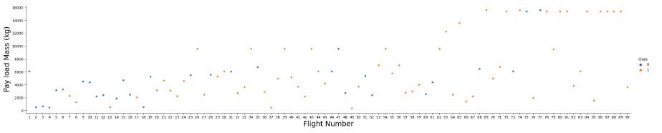
EDA with Data Visualization
We plotted scatter plots of Flight Number and Payload Mass to determine success rate
Applied-Data-Science-Capstone/04 Capsone Lab 4 EDA with Visualization Lab.ipynb at main · mberringer/Applied-Data-Science-Capstone · GitHub

Slide 12
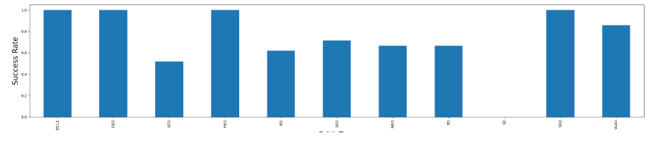
EDA with Data Visualization
We plotted bar charts to determine success rate of each orbit
Applied-Data-Science-Capstone/04 Capsone Lab 4 EDA with Visualization Lab.ipynb at main · mberringer/Applied-Data-Science-Capstone · GitHub

Slide 13
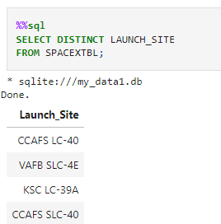
EDA with SQL
Names of unique launch sites
Applied-Data-Science-Capstone/03 Capsone Lab 3 Complete the EDA with SQL.ipynb at main · mberringer/Applied-Data-Science-Capstone · GitHub

Slide 14
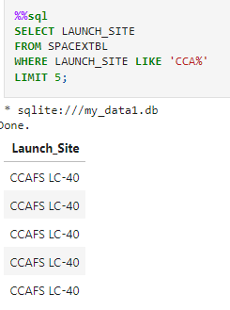
EDA with SQL
CCA launch sites
Applied-Data-Science-Capstone/03 Capsone Lab 3 Complete the EDA with SQL.ipynb at main · mberringer/Applied-Data-Science-Capstone · GitHub

Slide 15
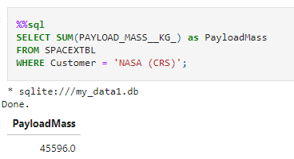
EDA with SQL
Total payload mass for NASA boosters
Applied-Data-Science-Capstone/03 Capsone Lab 3 Complete the EDA with SQL.ipynb at main · mberringer/Applied-Data-Science-Capstone · GitHub

Slide 16
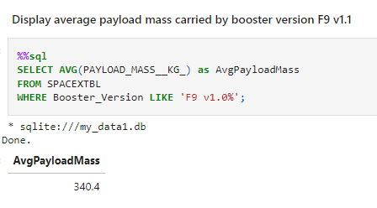
EDA with SQL
Average payload mass for booster Falcon 9
Applied-Data-Science-Capstone/03 Capsone Lab 3 Complete the EDA with SQL.ipynb at main · mberringer/Applied-Data-Science-Capstone · GitHub

Slide 17
EDA with SQL
First successful landing outcome on the ground pad
Name of boosters which have success in drone ship and have a payload mass between 4,000 and 6,000
Total Number of successful and failure mission outcomes
Booster version names that have carried the maximum payload mass
Landing outcome rank between 6/4/2010 and 3/20/2017
Applied-Data-Science-Capstone/03 Capsone Lab 3 Complete the EDA with SQL.ipynb at main · mberringer/Applied-Data-Science-Capstone · GitHub

Slide 18
Build an Interactive Map with Folium
We marked all launch sites on a map and added the success rate for each site
We calculated the distance between a launch site to its proximities
We used circles and labels to display launch sites
We used markers and lines to display the success rate of each site along with its proximity to other sites
Applied-Data-Science-Capstone/05 Capsone Lab 5 Interactive Visual Analytics with Folium.ipynb at main · mberringer/Applied-Data-Science-Capstone · GitHub

Slide 19
Build a Dashboard with Plotly Dash
Dash functions were used to generate an interactive app to toggle input using dropdown menus and sliders
Pie charts and scatterplots were used to show total launch success rate from each site and the correlation of payload mass to mission outcome per site
Applied-Data-Science-Capstone/06 Captstone Lab 6 Build and Interactive Dashboard with Ploty Dash.py at main · mberringer/Applied-Data-Science-Capstone · GitHub

Slide 20
Predictive Analysis (Classification)
Sklearn library was used to create the machine learning models
We plotted the confusion matrix for each of the models to determine effectiveness
Data was first standardized then split into training and testing data sets
Models created included:
Logistic regression
Support Vector machine (SVM)
Decision tree
K nearest neighbors (KNN)
Models were fit on the training set and the best combination of parameters for each model was determined
Model accuracy was based on the confusion matrix and accuracy scores
Applied-Data-Science-Capstone/07 Capsone Lab 7 Complete the Machine Learning Prediction lab.ipynb at main · mberringer/Applied-Data-Science-Capstone · GitHub

Slide 21
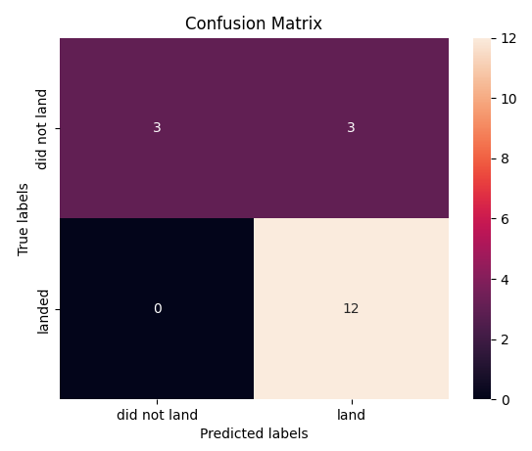
Results
Logistic regression
Major problem with false positives
Accuracy: 0.848

Slide 22
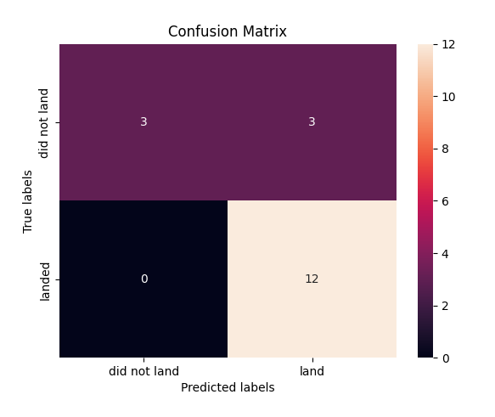
Results
Support Vector Machine
Accuracy: 0.833

Slide 23
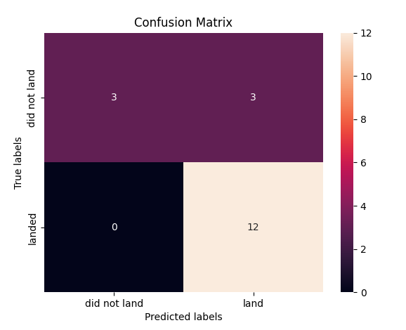
Results
Decision Tree
Accuracy: 0.875

Slide 24
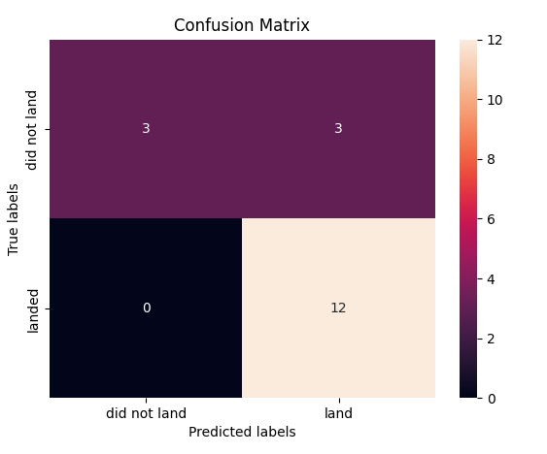
Results
K nearest neighbors (KNN)
Accuracy: 0.833

Slide 25
Results
Using each model GridSearchCV, the best scores are used to rank each model
The models are ranked in order below, best to worst
Decision Tree
K nearest neighbors
Support Vector machine
Logistic regression

Slide 26

Section 2

Slide 27
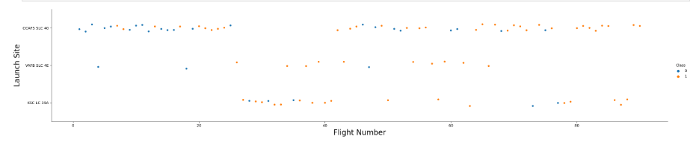
Flight Number vs. Launch Site
Show a scatter plot of Flight Number vs. Launch Site

Slide 28
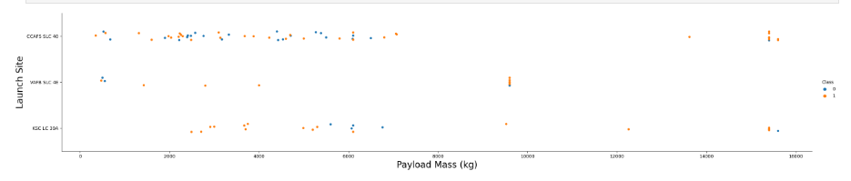
Payload vs. Launch Site
Show a scatter plot of Payload vs. Launch Site

Slide 29
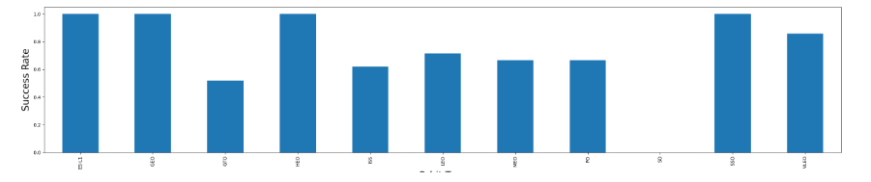
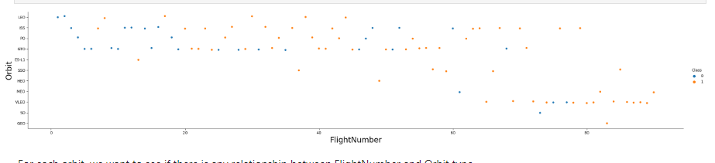
Success Rate vs. Orbit Type
Show a bar chart for the success rate of each orbit type
Show the screenshot of the scatter plot with explanations

Slide 30
Flight Number vs. Orbit Type
Show a scatter point of Flight number vs. Orbit type

Slide 31
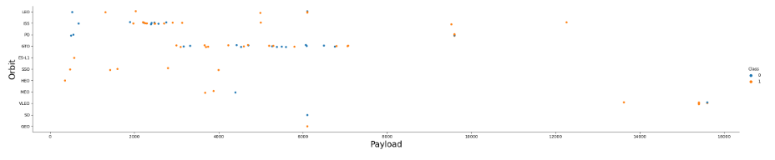
Payload vs. Orbit Type
Show a scatter point of payload vs. orbit type

Slide 32
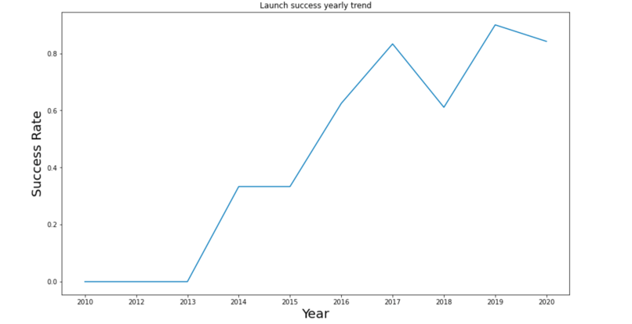
Launch Success Yearly Trend
Show a line chart of yearly average success rate

Slide 33
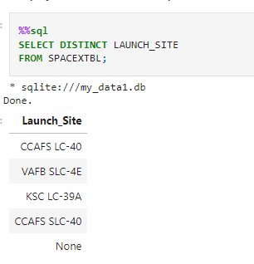
All Launch Site Names
Find the names of the unique launch site

Slide 34
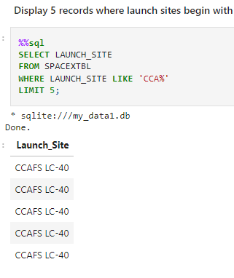
Launch Site Names Begin with 'CCA'
Find 5 records where launch sites begin with `CCA`

Slide 35
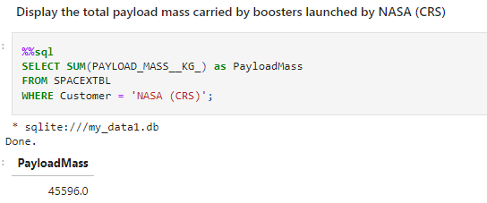
Total Payload Mass
Calculate the total payload carried by boosters from NASA

Slide 36
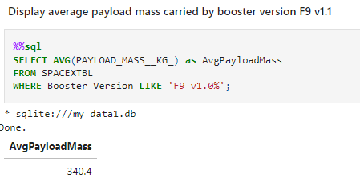
Average Payload Mass by F9 v1.1
Calculate the average payload mass carried by booster version F9 v1.1

Slide 37
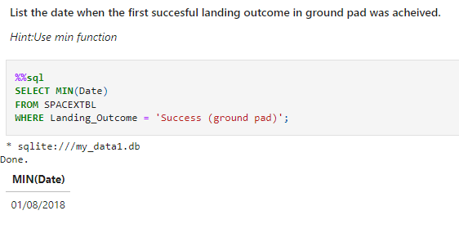
First Successful Ground Landing Date
Find the dates of the first successful landing outcome on ground pad

Slide 38
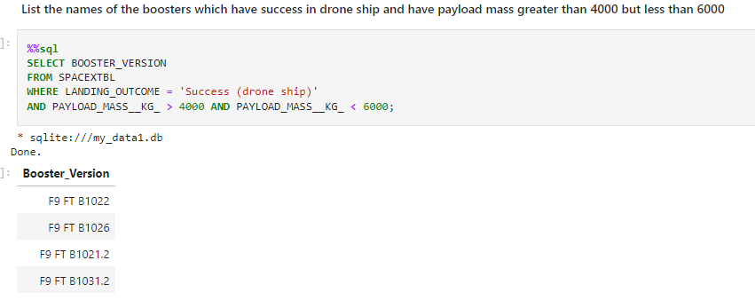
Successful Drone Ship Landing with Payload between 4000 and 6000
List the names of boosters which have successfully landed on drone ship and had payload mass greater than 4000 but less than 6000

Slide 39
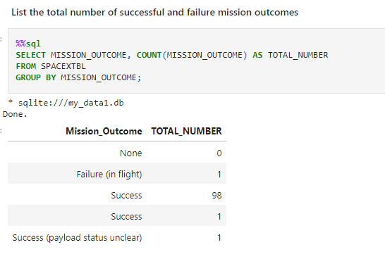
Total Number of Successful and Failure Mission Outcomes
Calculate the total number of successful and failure mission outcomes

Slide 40
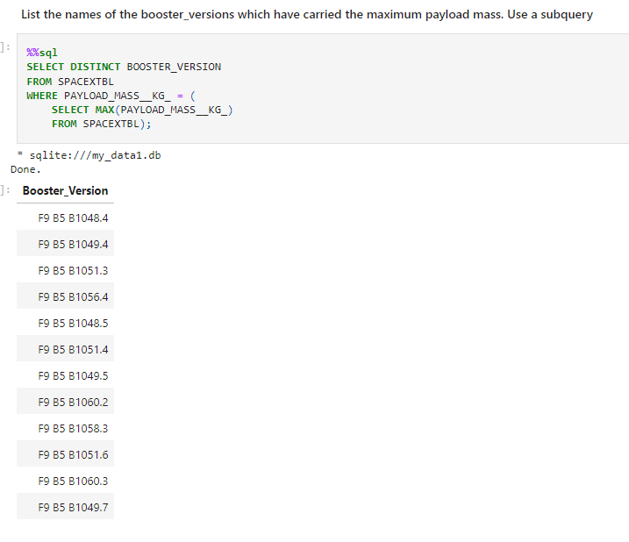
Boosters Carried Maximum Payload
List the names of the booster which have carried the maximum payload mass

Slide 41
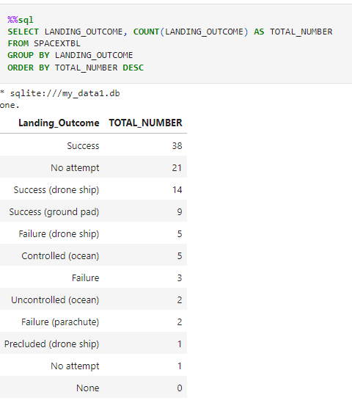
Rank Landing Outcomes Between 2010-06-04 and 2017-03-20
Rank the count of landing outcomes (such as Failure (drone ship) or Success (ground pad)) between the date 2010-06-04 and 2017-03-20, in descending order

Slide 42

Section 3

Slide 43
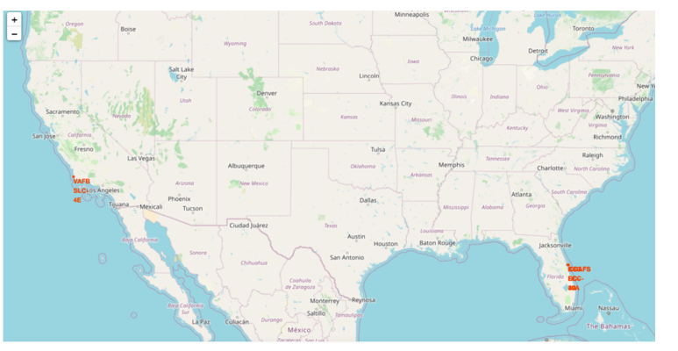
All Launch sites map

Slide 44
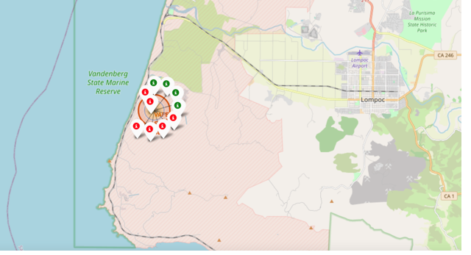
Success Rate for each launch site
Successful launch's per site
Zooming in shows green or red with green indicating a success and red indicating a failure

Slide 45
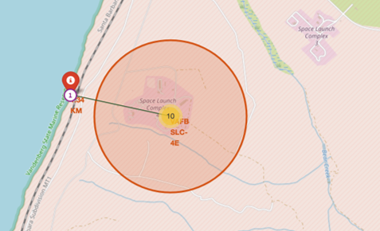
Distance between launch sites and proximities
The distance between a launch site and the proximity including the nearest city, highway or railway.
Proximity of Site VFAB SLC 4E to nearest coastline

Slide 46

Section 4

Slide 47
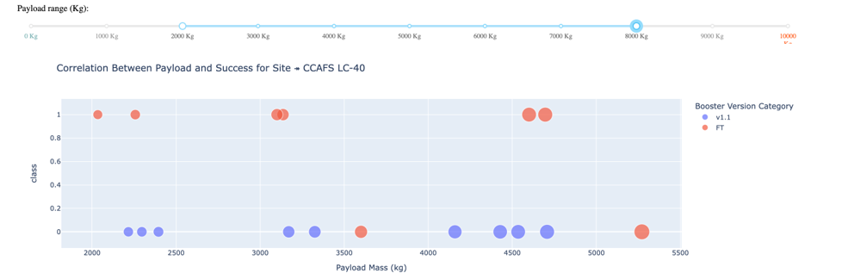
Payload mass and success rate

Slide 48

Section 5

Slide 49
Classification Accuracy
Decision Tree is the most accurate

Slide 50
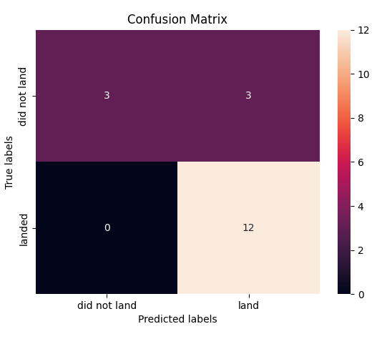
Confusion Matrix
Decision tree confusion matrix

Slide 51
Conclusions
We attempted to predict the success rate of the Falcon 9 booster given a set of parameters to determine the cost of each launch
Payload Mass, Orbit Type and launch site may impact the success rate
Using different machine learning models to make the prediction, the decision tree model was the most accurate

Slide 52


